Slide 1
React hooks

Slide 2
React hooks
A Hook is a special function that lets you “hook into” React features.
Hooks let you split one component into smaller functions based on what pieces are related (such as setting up a subscription or fetching data).

Slide 3
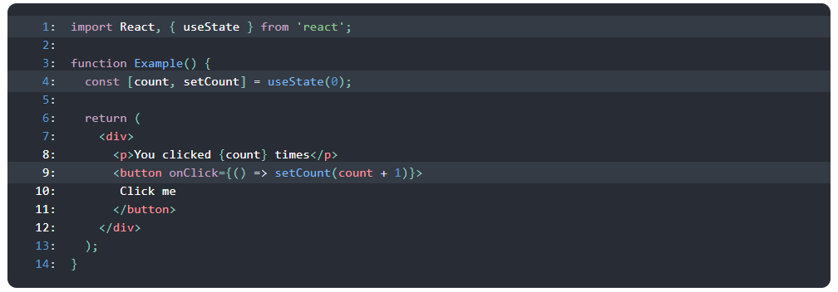
State hook
Is a Hook that lets you add React state to function components.
Notes:
Line 1: We import the useState Hook from React. It lets us keep local state in a function component.
Line 4: Inside the Example component, we declare a new state variable by calling the useState Hook. It returns a pair of values, to which we give names. We’re calling our variable count because it holds the number of button clicks. We initialize it to zero by passing 0 as the only useState argument. The second returned item is itself a function. It lets us update the count so we’ll name it setCount.
Line 9: When the user clicks, we call setCount with a new value. React will then re-render the Example component, passing the new count value to it.

Slide 4
Effect hook
The Effect Hook lets you perform side effects in function components.
Data fetching, setting up a subscription, and manually changing the DOM in React components are all examples of side effects.
By using this Hook, you tell React that your component needs to do something after render. React will remember the function you passed and call it later after performing the DOM updates.

Slide 5


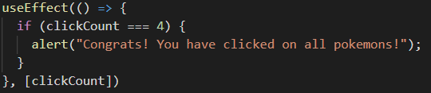
Common uses
Run just once
Run after every render
Run only after a specified prop/state change

Slide 6
Effect clean-up
This is equivalent to the componentWillUnmount function in class components
In your effect, just return the cleanup function.

Slide 7
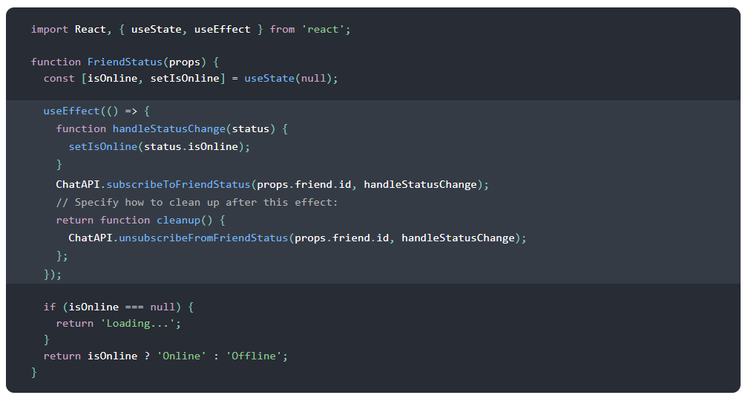
Effect clean-up

Slide 8
Rules of Hooks
Only call Hooks at the top level. Don’t call Hooks inside loops, conditions, or nested functions.
Only call Hooks from React function components. Don’t call Hooks from regular JavaScript functions.
PRO TIP: use this linter plugin to enforce these rules automatically:
https://www.npmjs.com/package/eslint-plugin-react-hooks

Slide 9
References
https://reactjs.org/docs/hooks-intro.html

